Slide 1
Counselor Learning Series 2017
Core Benefits
Providing Financial Wellness through Employer Sponsored Benefit Plans

Slide 2
Agenda – Benefits Overview
Medical Insurance
Dental Insurance
Vision Insurance
Group Term Life
Supplemental Term Life
401K
The Core and Voluntary Benefits

Slide 3
Employer Benefit Offerings
What is Medical Coverage?
Coverage that provides for the payments of benefits as a result of sickness or injury.
Why do employers offer Medical coverage?
As part of a comprehensive compensation package designed to be competitive in the marketplace
Benefits are a tool used for attraction and retention of a quality workforce
If communicated and administered effectively, they enhance efficiency, productivity, morale

Slide 4
Employer Benefit Offerings
Who is eligible to be enrolled?
Employee
Spouse
Eligible Dependents
Eligible natural or adopted children up to age 26
Handicapped dependents
Court order
Tier options typically available:
Employee, Employee + Spouse, Employee + Child(ren), Employee + Family
Employee, Employee + 1, Employee + Family
Employee, Family

Slide 5
Medical Coverage Types
Preferred Provider Organization (PPO)
Most prevalent type of healthcare plan in existence today
Network-based plan
Network providers agree to accept a negotiated (and reduced) rate for services
Network providers may not charge more than negotiated rate
Both the plan and the participant save money
Benefits are paid if you use non-network providers, although at a lower level (typical is 90/70, 80/60, etc.)
No PCP required
May access in-network specialty care or out-of-network care without a referral
Network providers are independent contractors

Slide 6
Medical Coverage Types
Health Maintenance Organization (HMO)
Network-based plan
Network is usually smaller than PPO network
Benefits usually paid only if you use network providers
Primary care physician (PCP) (aka “Gatekeeper”) may coordinate all care
Specialty care often requires referral from PCP
Two types
Staff Model – most disciplines located within one facility
Doctors may be employees of the HMO (e.g. Kaiser)
IPA Model – doctors maintain their own offices
Doctors are like independent contractors
Physician payment often based on “capitation

Slide 7
Medical Coverage Types
Point of Service (POS)
Network-based
Network is usually smaller than PPO network
Benefits are paid if you use non-network providers, although at a much lower level (i.e. 90 paid in-network / 70% out-of-network)
PCP may coordinate all care, unless “open access” plan
Referral required for in-network specialty care
Network providers are independent contractors and not employed by insurance company
May look very similar to PPO plans, with lower out-of-network coverage (higher coinsurance & deductibles, etc.)

Slide 8
Medical Coverage Types
Indemnity
Not network-based, often used because networks not available
Benefits are the same, regardless of provider used (coinsurance)
No PCP
No referrals from PCP
No network discounts
Most benefit plans pay a percentage of reasonable and customary (R&C) charges
Providers whose fees are in excess of R&C may bill patients for additional amounts owed
Very costly to employer and employee

Slide 9
Medical Coverage Types
Exclusive Provider Organization (EPO)
Benefit structure similar to HMO (e.g., rich in-network benefits; little or no benefits paid out-of-network)
No PCP required
Physician reimbursement is not like an HMO
Not priced as competitively as an HMO
Developed by insurers who don’t have a true HMO product but want to offer their clients an HMO-type benefit

Slide 10
Medical Coverage Types – Sample Plan Design
 | HMO |  | POS |  | PPO |  | INDEMNITY
 | In-Network | Out-of-Network | In-Network | Out-of-Network | In-Network | Out-of-Network | In-Network | Out-of-Network
Deductible | $0 | N/A | $300 individual | $600 individual | $500 individual | $1000 individual | N/A | $600 individual
Co-insurance | 100% | N/A | 90% | 70% | 80% | 60% | N/A | 80%
Dr. Office Visit | $15 | N/A | $20 | 70% | $35 | 60% | N/A | 80%
Out of Pocket Limit | $1,000 individual | N/A | $1,500 individual | $3,000 individual | $2,000 individual | $4,000 individual | N/A | $2,500 individual

Slide 11
Medical Out of Pocket Costs
 | HMO |  | POS |  | PPO |  | INDEMNITY
 | In-Network | Out-of-Network | In-Network | Out-of-Network | In-Network | Out-of-Network | In-Network | Out-of-Network
Deductible | $0 | N/A | $300 individual | $600 individual | $500 individual | $1000 individual | N/A | $600 individual
Co-insurance | 100% | N/A | 90% | 70% | 80% | 60% | N/A | 80%
Dr. Office Visit | $15 | N/A | $20 | 70% | $35 | 60% | N/A | 80%
Out of Pocket Limit | $1,000 individual | N/A | $1,500 individual | $3,000 individual | $2,000 individual | $4,000 individual | N/A | $2,500 individual
What the employee needs to pay – also referred to as
Gaps In Coverage

Slide 12
Consumer Driven Healthcare
CDHP (Consumer Driven Healthcare Plan)
Many employers are moving toward this plan type
Also referred to as a High Deductible Healthcare Plan (HDHP)
Creates larger gaps in coverage, and expands the opportunity for supplemental voluntary coverage to be offered
Provides cost savings for the employer
Payroll deduction for the employee is generally lower than a standard PPO type plan option
Requires the employee to be more involved in making educational choices regarding all aspects of their health care
Preventive care such as physicals, mammograms and well child care is typically covered at 100%
The employee carries the burden of the cost of non-preventive care services rendered prior to meeting the deductible (including the cost for prescription drugs)

Slide 13
Consumer Driven Healthcare
Employer/Employee Accounts
Members receive an annual allocation of health care funds from their employer that they may use to pay for covered services
Employees can sometimes also allocate dollars to a health care fund to supplement the employer contribution.
Health Savings Account (HSA)
Contributions by employer and employee – there are maximum allowable contributions for the employee
Owned by the employee and employee controls the funds, even if they leave the employer
Does not cover cost of insurance premium
Must be combined with a high deductible healthcare plan
Employee must open a new bank account to receive or contribute funds
Healthcare Reimbursement Account (HRA)
Contributions by employer only
Owned by the employer and employee can access funds when a service is rendered, employees lose any available funds if they leave the employer
Employer can select which benefits are covered

Slide 14
Dental
What is Dental Insurance?
Dental insurance works in much the same way that medical insurance works.
For a specific monthly rate (or "premium"), you are entitled to certain dental benefits, usually including regular checkups, cleanings, x-rays, and certain services required to promote general dental health.
Some plans will provide broader coverage than others and some will require a greater financial contribution on your part when services are rendered.
Some plans may also provide coverage for certain types of oral surgery, dental implants, or orthodontia.
Indemnity Plans as well as DHMOs (Dental HMO type plans) may be available, but most standard plan type mirrors a PPO type plan

Slide 15
Dental Plan Design
Plan design typically includes
Deductible and Maximum Annual Benefit Limit
100% Coverage for Type I Services
80% or lower coverage for Type II Services
50% or lower coverage for Type III Services
50% or lower coverage for Type IV Services
Types of services
Type I – Preventive (oral exams, cleanings, X-rays, fluoride/sealants)
Type II – Basic Restorative – (fillings, extractions, periodontics, endodontics)
Type III – Major Restorative – (crowns, bridges, dentures)
Type IV – Orthodontics (braces) May have separate deductible and lifetime
maximum

Slide 16
Vision
What is Vision Insurance?
Vision insurance is a wellness benefit designed to reduce your costs for routine, preventive eye care such as eye exams, eyewear and other services.
Vision insurance policies typically cover routine eye exams and other procedures, and provide specified dollar amounts or discounts for the purchase of eyeglasses and contact lenses.
May include co-pays and fixed dollar amounts
May provide discounts only
Some vision insurance policies also offer discounts on refractive surgery, such as LASIK.
Employees may be required to utilize a specific network of providers to receive benefits.
Vision insurance only supplements regular health insurance. Regular health insurance plans protect you against financial loss due to unexpected eye injury or disease.

Slide 17
Basic Term Life Insurance
What is Basic Term Life Insurance Coverage?
Basic Life Insurance is typically provided to employees as an employer paid benefit.
Basic Life Insurance is a term life insurance benefit
Covers the employee for a specific term or period of time, typically until they reach a specific age or leave the company
Benefit may reduce at advanced ages
In the event of the employee’s death, a cash payment will be made to the employee’s designated beneficiary or beneficiaries.
The amount of payment is determined by the coverage amount which may be calculated as a:
Flat amount (ex: $25,000), or
Salary based amount (ex: 1 x salary)
Typically accompanied by an Accidental Death & Dismemberment policy which provides a similar coverage amount

Slide 18
Basic Term Life Insurance
Nuances of Basic Term Life
Benefit is typically communicated, and employee is automatically enrolled (some plans allow for an opt out)
Employees must designate a beneficiary
Primary Beneficiary – a specific person or entity, or a combination of such for which the employee must specify distribution of funds that must equal 100%
Contingent Beneficiary – designee for funds in the event they can not be distributed to the primary beneficiary
Dependent Life Insurance may also be provided
Typically a flat benefit amount for spouse and dependent children
Employee is typically automatically the beneficiary for this policy

Slide 19
Supplemental Term Life Insurance
What is Supplemental Term Life Insurance Coverage?
Supplemental Life Insurance is provided to employees as an employee paid benefit.
Allows the employee to purchase additional term life insurance for themselves and their dependents
Employee can typically select separate beneficiaries for supplemental life from the beneficiaries they selected for their Basic Life policy
The amount of payment is determined by the coverage amount which may be calculated as a:
Flat amount (ex: increments of $10,000), or
Salary based amount (ex: 1 x salary)
Supplemental Accidental Death & Dismemberment is typically a separate option offered to the employee

Slide 20
Supplemental Term Life Insurance
Nuances of Supplemental Term Life
The cost of coverage typically changes every five years, increasing in cost as the employee gets older.
Many employers do not allow provisions for the benefits selected to be “ported” at the same rates. This means an employee either has to pay more to continue the coverage if they leave their employer, or need to convert their plan to more expensive individual plan through the insurance company

Slide 21
Supplemental Life Insurance
What is EOI?
Specific amounts of coverage may be automatically granted to an employee. These amounts are considered to be Guaranteed Issue (GI)
The employee may elect to purchase coverage over and above the Guaranteed Issue amount. They will need to submit Evidence of Insurability or EOI
The insurance carrier may approve or decline the benefit amounts subject to EOI.

Slide 22
Supplemental Life Insurance
Example
ABC Company offers Supplemental Life as follows:
Employee: $10,000 to $100K in $10K increments. GI $30,000
Spouse: $5,000 to $50,000 in $5K increments. GI $15,000
Child(ren): $2,500 or $5,000, both GI
Employee: Can apply for up to $100K, but payroll deduction would start for a max of $30,000. Employee may or may not be approved for the additional $70,000. The employer will be notified of approval status
Spouse: Employee can apply for up to $50,000 in spouse supp life, but payroll deduction would start for a max of $15,000. Employee’s spouse may or may not be approved for the additional $35,000. The employer will be notified of approval status.
Child: Can apply for up to $5,000. Either election of $2,500 or $5,000 would begin on initial payroll.

Slide 23
401k
What is a 401k?
Most popular offered retirement savings account
Typically a benefit Aon communicates, but does not enroll
Most often communicate
When is an employee eligible to participate
What can an employee contribute
Does the employer provide a match, and if so what amount
Website / tel number for 401k Administrator

Slide 24



Voluntary Benefits
Providing a Financial “Safety Net” for employees and their family
Fully funded upon issue
Can be used for any purpose
Tax free benefit paid directly to insured
Flexible design to support CDHP
Related benefits to complete the financial wellness “picture”:
Critical Illness
Accident Plan
Hospital Indemnity

Slide 25

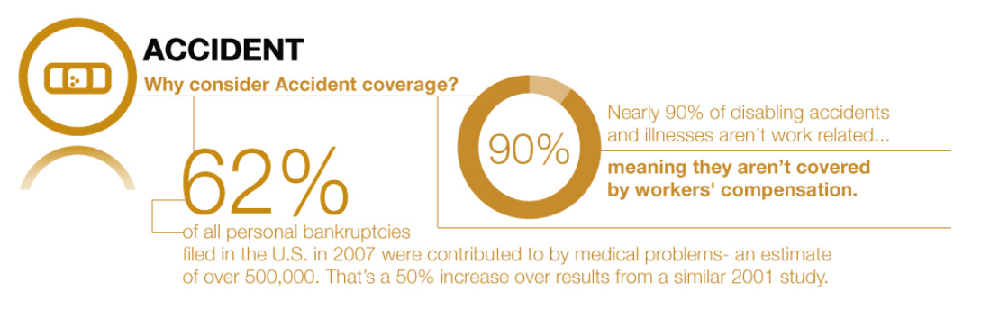
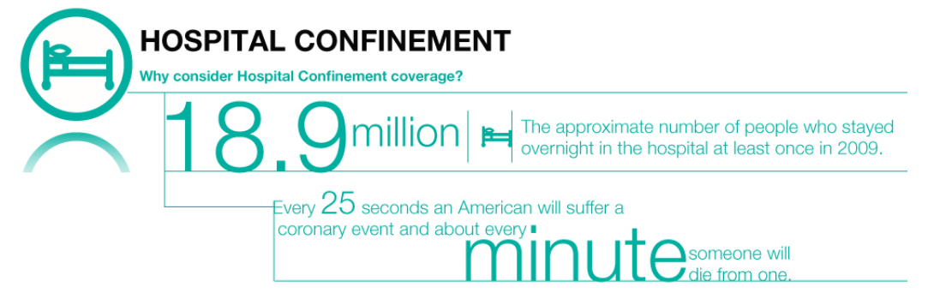
A Case for Voluntary Coverage
Provides the protection one needs in the event of a heart attack, stroke, end stage renal failure, cancer, by pass surgery or any other covered major illness.
Gives financial security in the in the event of an accident. Can provide both on and off-the-job coverage.
With substantial out-of-pocket expenses associated with a CDHP, do you have adequate discretionary funds to cover the deductible and coinsurance maximums?

Slide 26
Thank You.

